Slide 1
Chapter 6 Decision Tree Learning

Slide 2
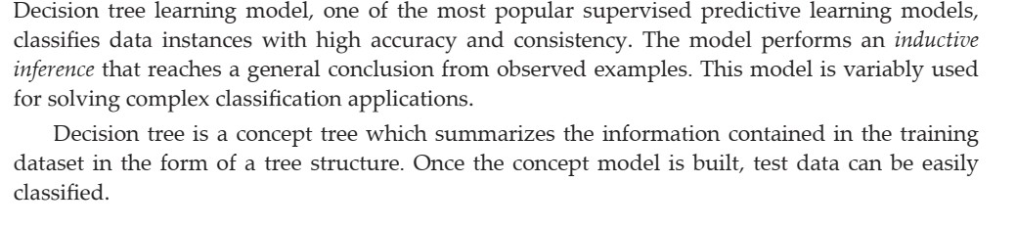
Decision Tree Learning Model

Slide 3
1.Model will classify both categorical and continuous valued target variables.
2.For a given training set X, hypothesis function f(X)as a decision tree.
3.The Decision tree generated a complete hypothesis space as a tree and allow us to search through the possible set of hypothesis.

Slide 4
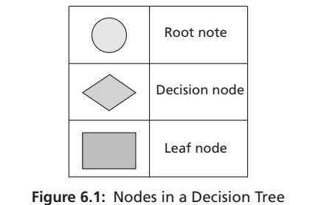
Structure of a Decision Tree

Slide 5
1.It is a structure with root node ,internal node/decision nodes, branches and leaf nodes. 2.Topmost tree node is root node
3.Internal nodes are test nodes and also decision nodes
4.These nodes represent a choice or test an input attribute and the outputs for a test condition.
5.The branches are labelled as per the outcomes or output values of the test condition.
6.Each decision is a path to a leaf node .
7.The leaf nodes represent the label or outcomes of a decision path.
8.Every path from root to leaf node represents the logical rule corresponds to a conjunction of test attributes and the whole tree represents the disjunction of these conjunctions

Slide 6
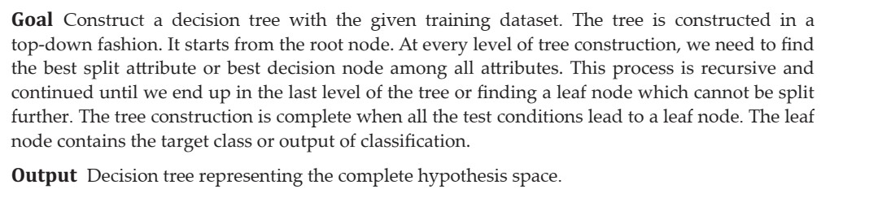
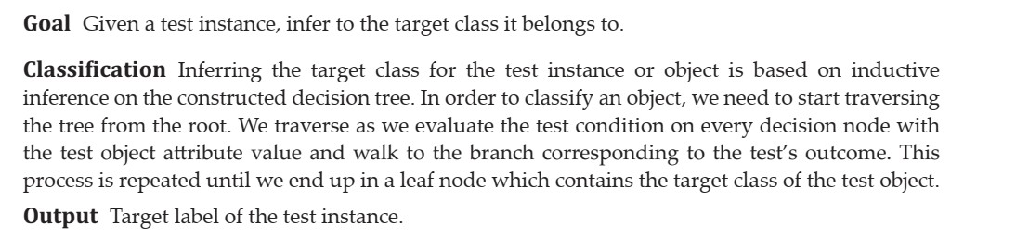
Structure of a Decision Tree
BUILDING THE TREE
KNOWLEDGE INFERENCE OR CLASSIFICATION

Slide 7
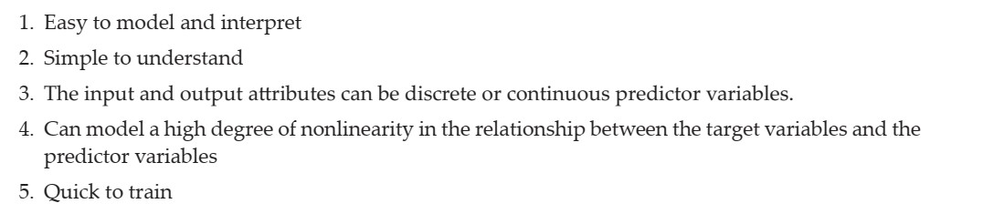
Advantages of Decision Trees

Slide 8
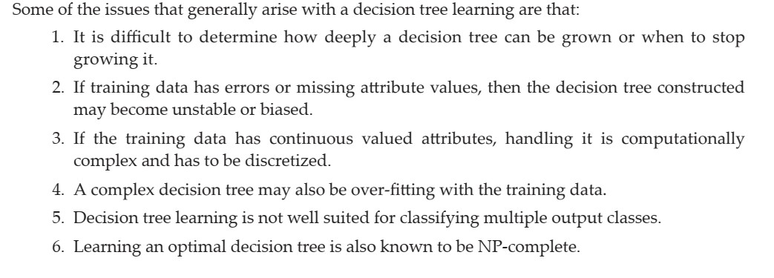
Disadvantages of Decision Trees

Slide 11
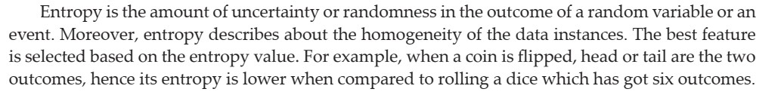
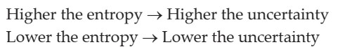
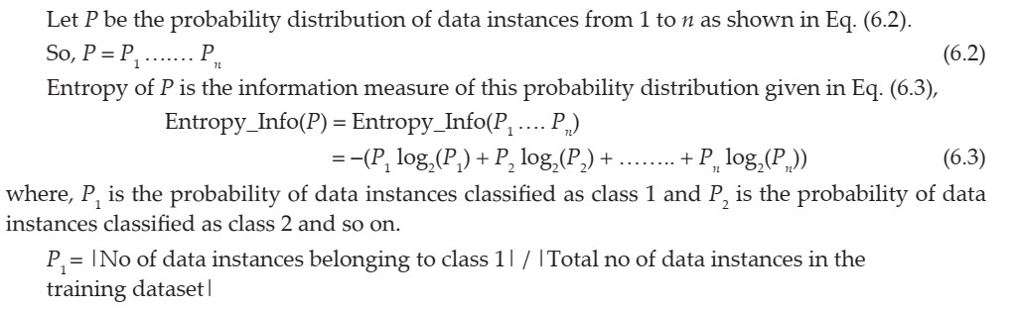
Fundamentals of Entropy

Slide 12
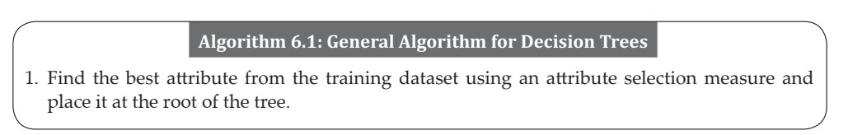
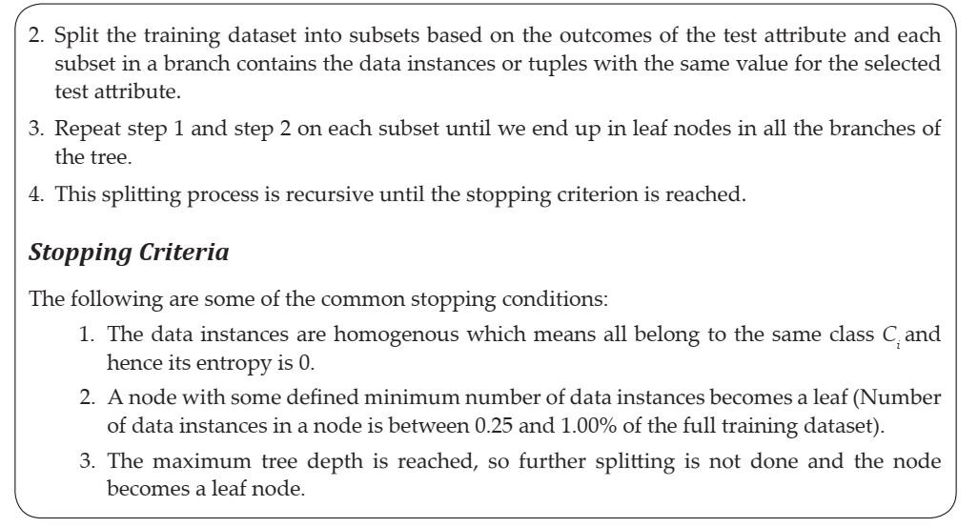
General Algorithm for Decision Trees

Slide 13
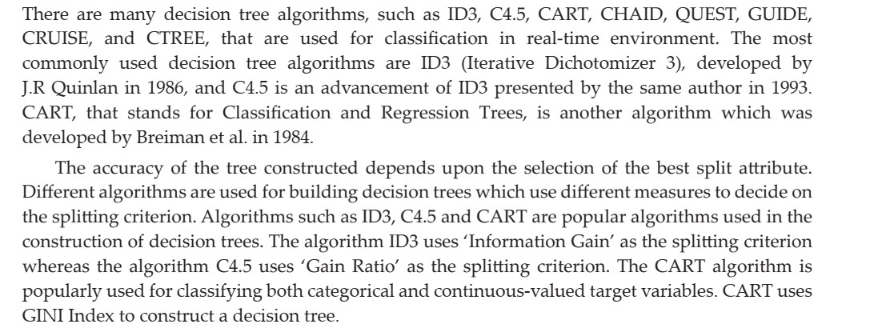
Decision Tree Induction Algorithms

Slide 14
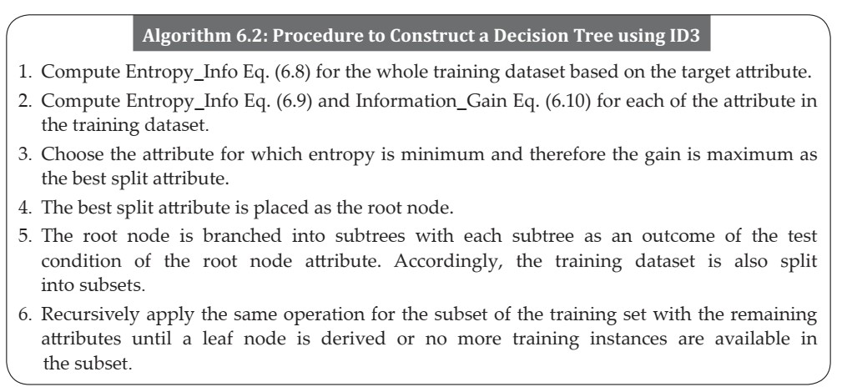
ID3 Tree Construction
1.ID3 is an example of univariate decision tree with only one feature at each decision node →axis aligned splits.
2.It constructs the tree using greedy approach in a top down fashion by identifying the best attribute of each level in the tree.
3.Works fine for discrete, otherwise it has to partitioned attributes to discrete features

Slide 15
The algorithm builds a tree using pruning measure “information Gain” with given training dataset and constructed tree to classify test data.
Works fine for larger dataset.
Small dataset overfitting
Not accurate if missing values.
C4.5 and CART handle discrete and continuous values
. C4.5 and CART handle missing data as well.
C4.5 is prone to outliers and CART handle it well.

Slide 23
C4.5 Construction
1.Works with missing values by marking ‘?’
2.Buids C5.0
3.Occam’s Razor problem ,two correct solutions, the simple one is chosen.
4.Need larger dataset for accuracy .
5.Uses gain ration as a measure during the construction of decision tree.

Slide 24
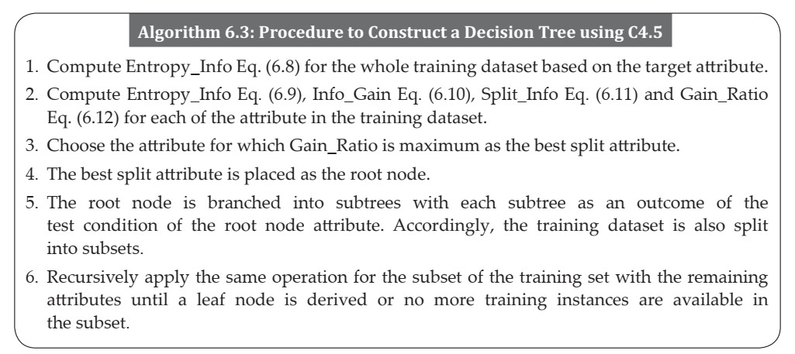

Slide 38
Classification and Regression Trees Construction
1.Multivariate decision tree algorithm
2.Oblique splits
3.Categorical ->classification tree otherwise ->regression tree.
4.Uses GINI index to construct decision tree
5.GINI ->number of data instances or its proportion of instances
6.Tree construction by splitting the nodes into two nodes
7.If an attribute has more than two possible values, GINI index is calculated for all the subsets of the attributes and the subset which has a maximum value is selected as the best split subset.

Slide 40
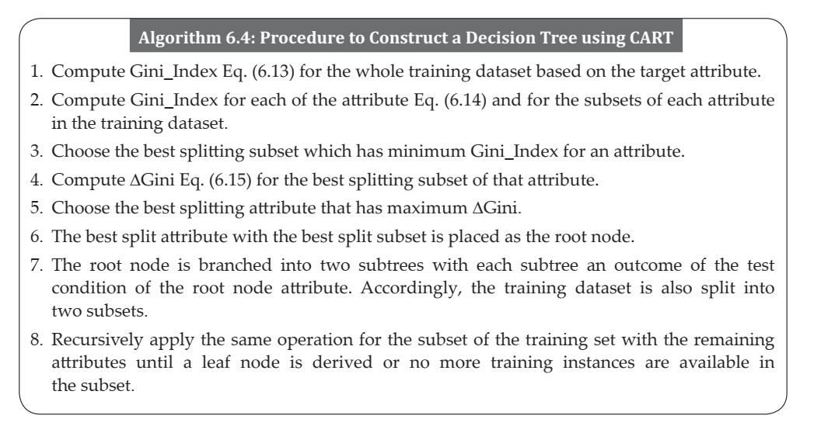

Slide 55
Regression Trees
1.Variant of decision tree with continuous .
2.Uses reduction in variance which uses standard deviation to choose the best splitting attribute.

Slide 64
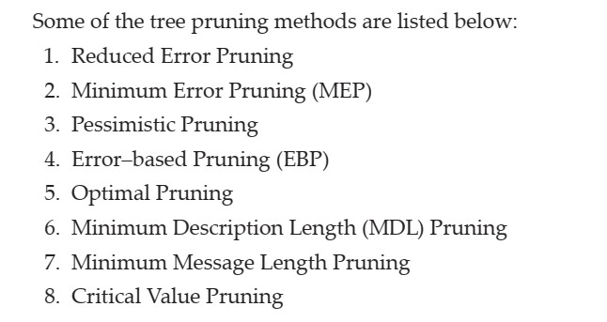
Validating and Pruning of Decision Trees

Slide 65
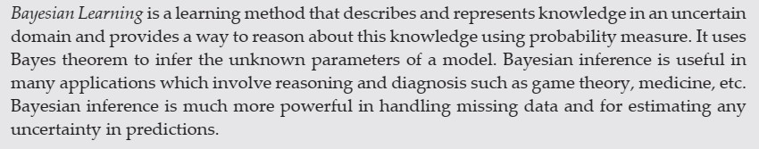
Chapter 8 -Bayesian Learning

Slide 66
Probability based learning
Prior knowledge or prior probabilities with observed data.
How to model the randomness ,uncertainty and noise to predict future events.
Probabilistic model –randomness deterministic –no randomness
Naïve bayes and Bayesian Belief Network (BBN)

Slide 67
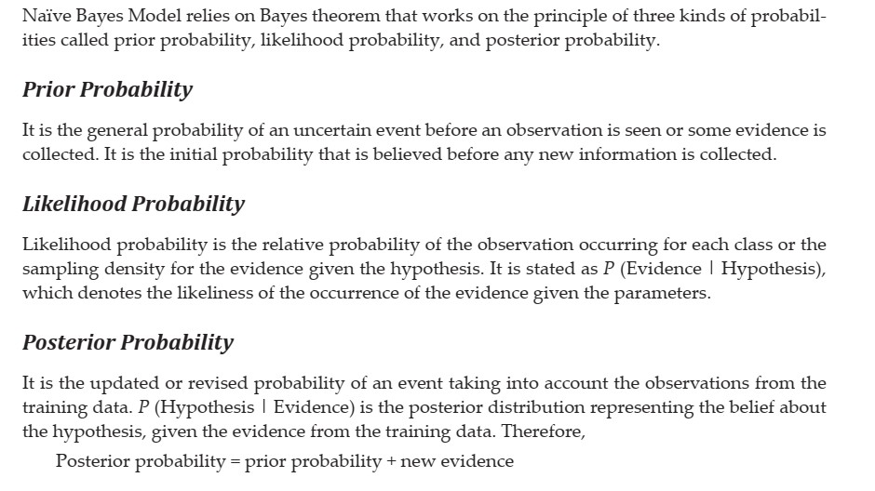
Fundamentals of Bayes Theorem

Slide 68
Classification Using Bayes Model
Based on Bayes principle
Based on mathematical formula used to determine posterior probability ,given prior probabilities of events .
Based on prior knowledge and posterior distributions
Hypothesis h is the target class to be classified and evidence E is the given test instance

Slide 69
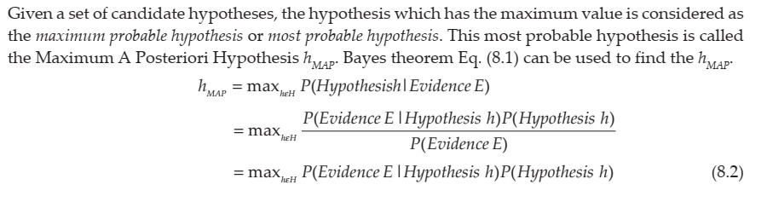
Maximum A Posteriori (MAP) Hypothesis, h_{MAP}

Slide 70
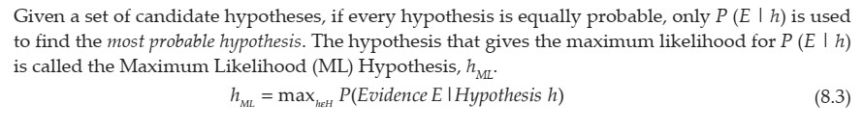
Maximum Likelihood (ML) Hypothesis, h_{ML}

Slide 72
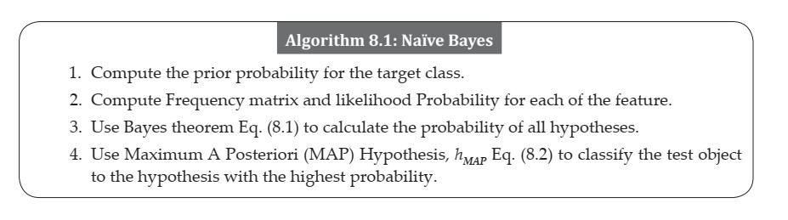
Naïve Bayes Algorithm

Slide 80
ZERO PROBABILITY ERROR
Zero-probability error can be solved by applying a smoothing technique called Laplace correction which means given 1000 data instances in the training dataset, if there are zero instances for a particular value of a feature we can add 1 instance for each attribute value pair of that feature which will not make much difference for 1000 data instances and the overall probability does not become zero.

Slide 84
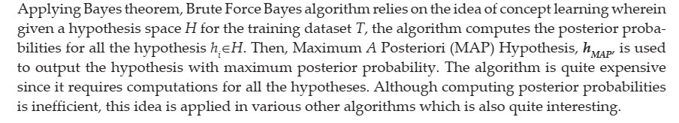
Brute Force Bayes Algorithm

Slide 85
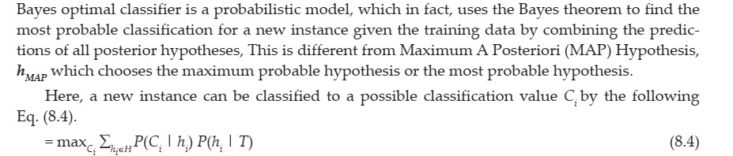
Bayes Optimal Classifier

Slide 86
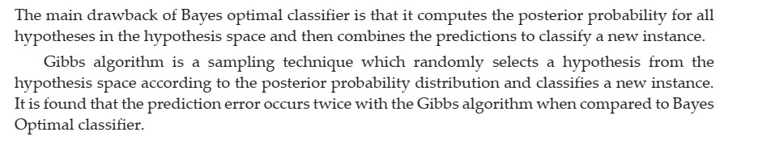
Gibbs Algorithm

Slide 87
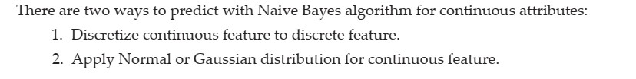
Naïve Bayes Algorithm For Continuous Attributes
GAUSSIAN NAIVE BAYES ALGORITHM
IN GAUSSIAN NAIVE BAYES, THE VALUES OF CONTINUOUS FEATURES ARE ASSUMED TO BE SAMPLED FROM A GAUSSIAN DISTRIBUTION.

Slide 94
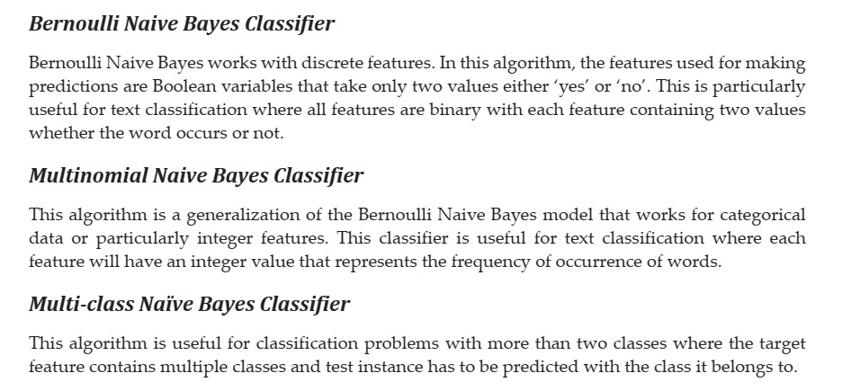
Other Popular Types of Naive Bayes Classifiers

Slide 95
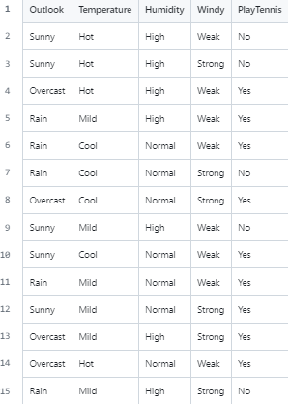
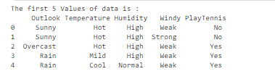
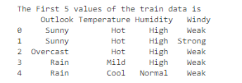
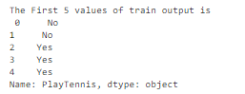
# import necessary libraries
import pandas as pd
from sklearn import tree
from sklearn.preprocessing import LabelEncoder
from sklearn.naive_bayes import GaussianNB
# Load Data from CSV
data = pd.read_csv('tennisdata.csv')
print("The first 5 Values of data is :\n", data.head())
# obtain train data and train output
X = data.iloc[:, :-1]
print("\nThe First 5 values of the train data is\n", X.head())
y = data.iloc[:, -1]
print("\nThe First 5 values of train output is\n", y.head())

Slide 96
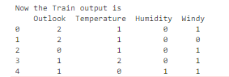
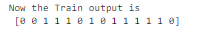
# convert them in numbers
le_outlook = LabelEncoder()
X.Outlook = le_outlook.fit_transform(X.Outlook)
le_Temperature = LabelEncoder()
X.Temperature = le_Temperature.fit_transform(X.Temperature)
le_Humidity = LabelEncoder()
X.Humidity = le_Humidity.fit_transform(X.Humidity)
le_Windy = LabelEncoder()
X.Windy = le_Windy.fit_transform(X.Windy)
print("\nNow the Train output is\n", X.head())
le_PlayTennis = LabelEncoder()
y = le_PlayTennis.fit_transform(y)
print("\n Now the Train output is\n",y)

Slide 97
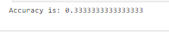
from sklearn.model_selection import train_test_split
X_train, X_test, y_train, y_test = train_test_split(X,y, test_size = 0.20)
classifier = GaussianNB()
classifier.fit(X_train, y_train)
from sklearn.metrics import accuracy_score
print("Accuracy is:", accuracy_score(classifier.predict(X_test), y_test))

